Slide 1

SHIVER ME TIMBERS!
Programs for $25 or less!
Presented by Sarah Amazing, Teen Librarian
Warren-Trumbull County Public Library

Slide 2
All of these programs can be done for about $25.
If you have a bit more to spend on prizes & aptly-themed food,
GO FOR IT!
But you don’t need it. The teens will have fun regardless.

Slide 3
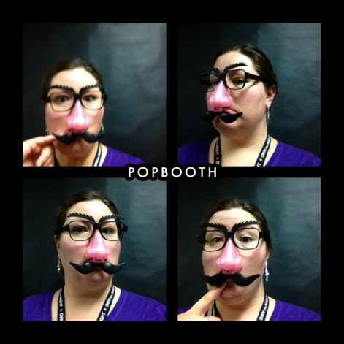
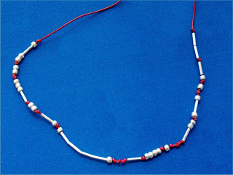
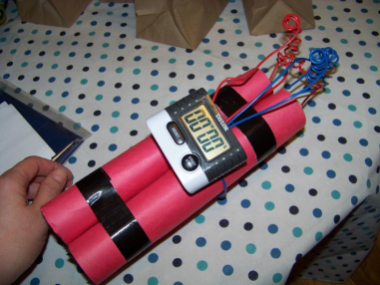
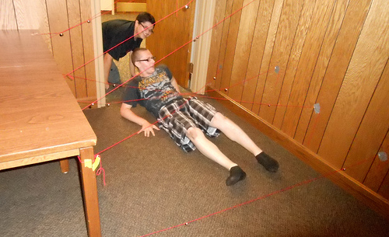
LIVE & LET SPY
A celebration of James Bond, Ally Carter,
Spy vs Spy, & more!
Codes: creation & decoding
Laser grid training
Spy trivia
Photo op with disguises
Invisible ink
Morse code bracelets
Agent code names
Spy vs Spy “Hot potato” bomb
Computer hacking simulation
Bonus: Watch Skyfall or other
James Bond movie!

Slide 4
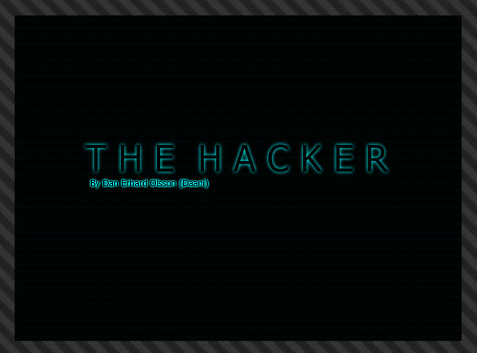
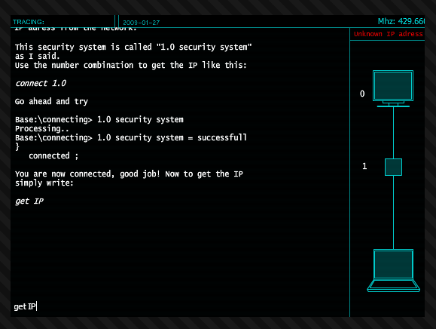
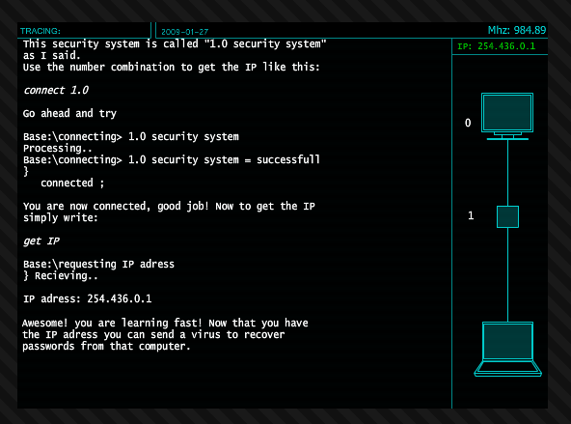
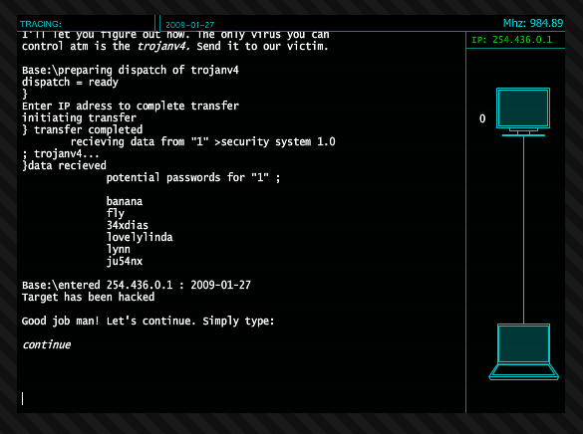
LIVE & LET SPY

Slide 5
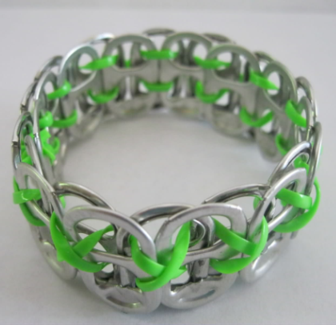
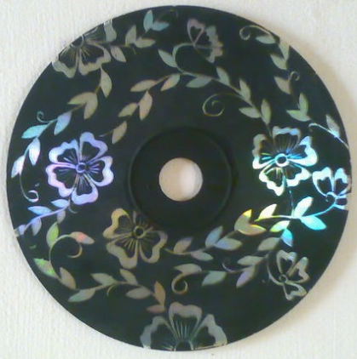
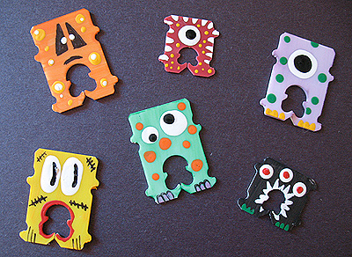
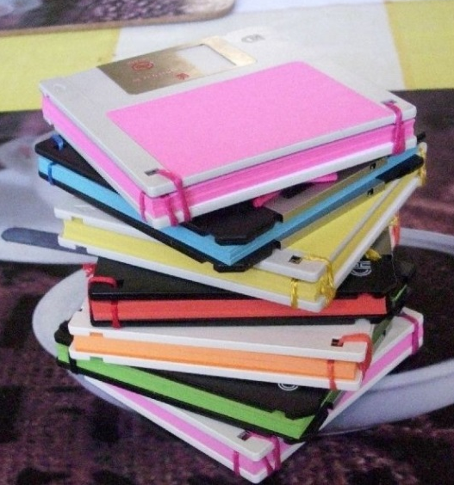
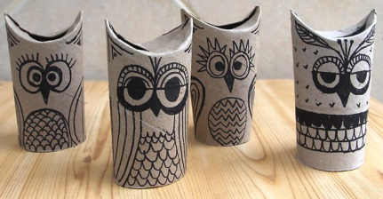
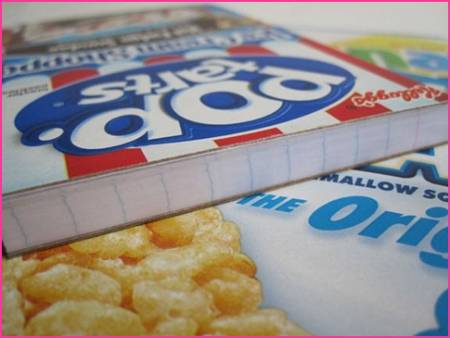
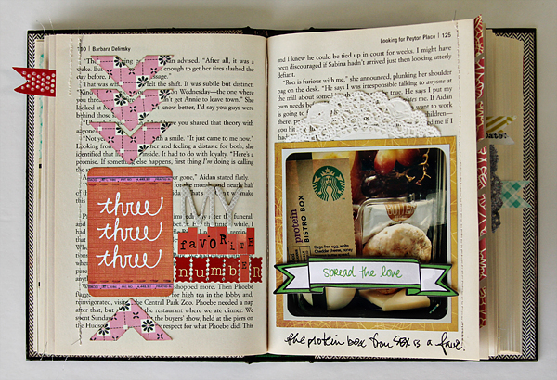
RECYCLED CRAFTS
It’s an upcycled party! The best part?
Many of these use old library materials!
Floppy disk notepads
Bread tag monsters
Smash journals
CD Art
Pop tab bracelets
Notepads & notebooks
Paper towel owls

Slide 6
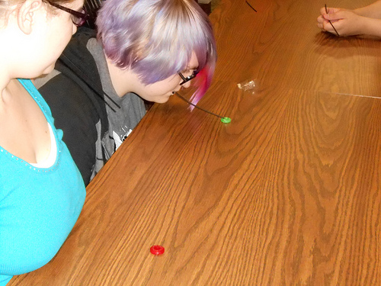
SUPERHEROES VS VILLAINS
ULTIMATE CHALLENGE
Perfect for Free Comic Book Day or
next summer’s theme!
Part 1: Choose your side & make a costume! Masks & plastic tablecloth.
Part 2: Trivia
Part 3: Team challenges with the emphasis on team, such as:
Working under pressure: Lifesaver Relay
Teamwork: Marble Relay (with spoons)
Weapon creation: origami shuriken
Logic: Oops! iPad game
Stressful environment: Balloons in the air

Slide 7
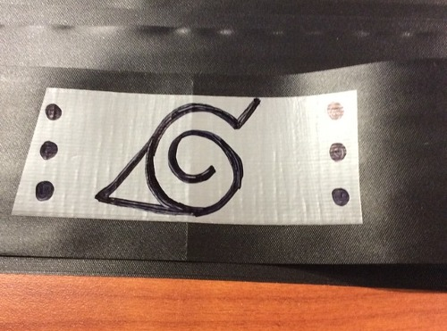
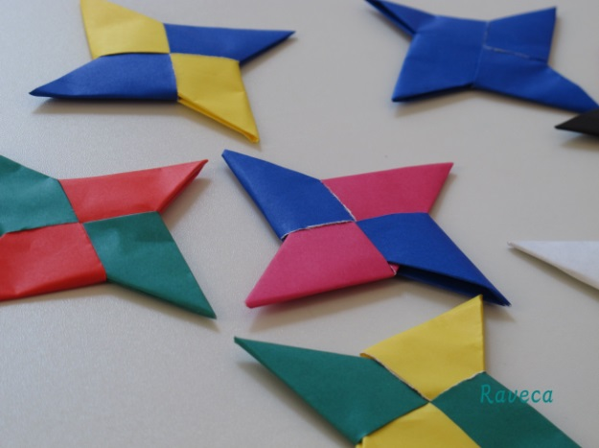
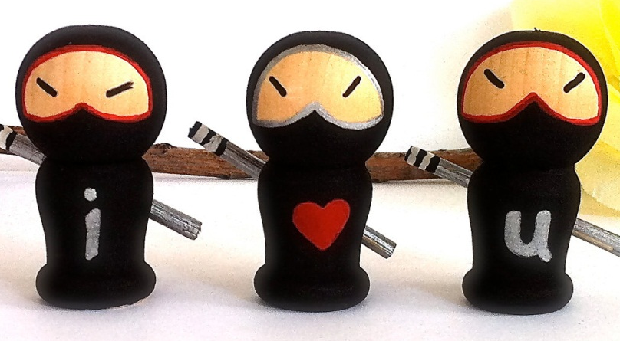
NIGHT OF THE NINJA
A rare celebration of silence!
Origami shuriken
Stealth challenges
>> pull out Silent Library challenges!
Kokeshi dolls
Trivia
Ninja village headbands
Watch episodes of Naruto
with free Crunchyroll account!
Note: Naruto is ending soon,
after 15 years. Great time for a party!

Slide 8
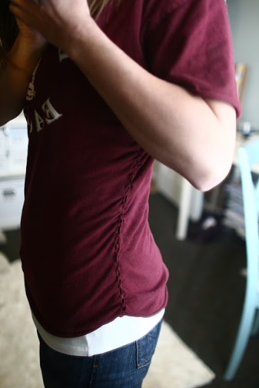
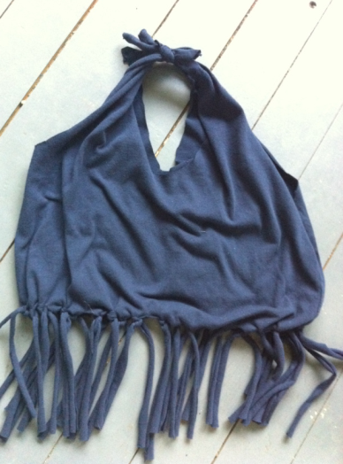

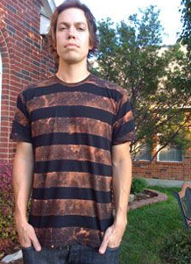

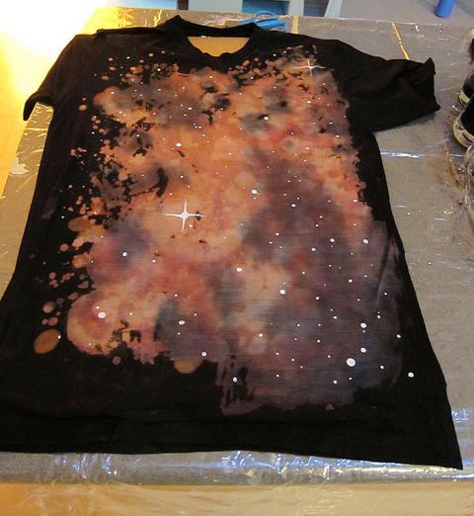
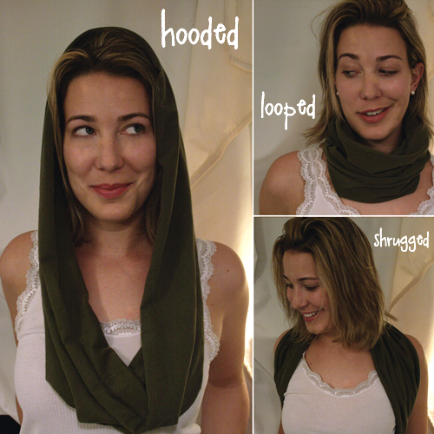
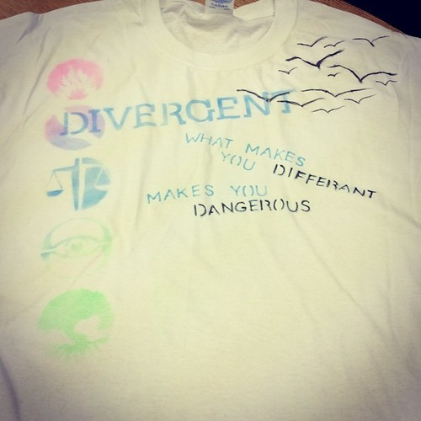
T-SHIRT TRANSFORMATIONS
So many amazing things to do with a basic t-shirt!

Slide 9
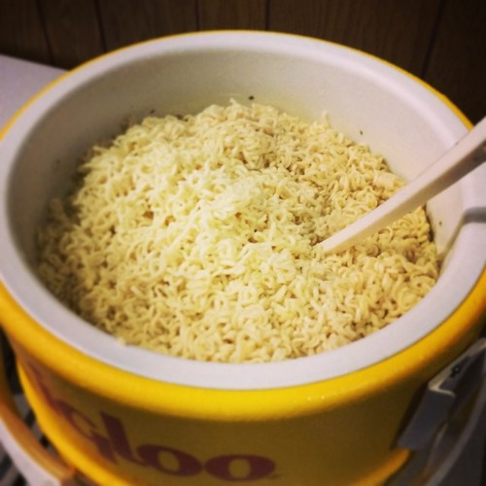
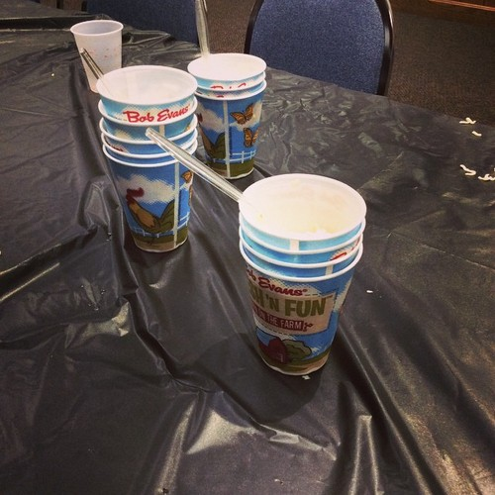
RAMEN NOODLE EATING CONTEST
Programs do not get any easier than this!
Pair it with your anime club or just host it as a one-shot!
Then watch some anime from Crunchyroll.
You’ll need:
Several multi-pack boxes of ramen
giant Igloo beverage dispenser
Something in which to heat water
Cups & spoons
Hungry teens
>> Whoever eats the
most ramen in ten
minutes wins!

Slide 10

ON THEIR OM: YOGA & MORE
A combination of yoga & healthy eating. Teens get stressed out, too!
Yoga: Sun salutation & moon salutation
Healthy food:
Baked kale chips with salt
Cucumber water
Sauteed chickpeas with chili powder

Slide 11
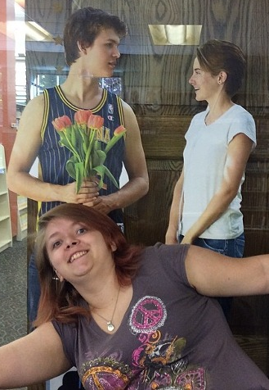
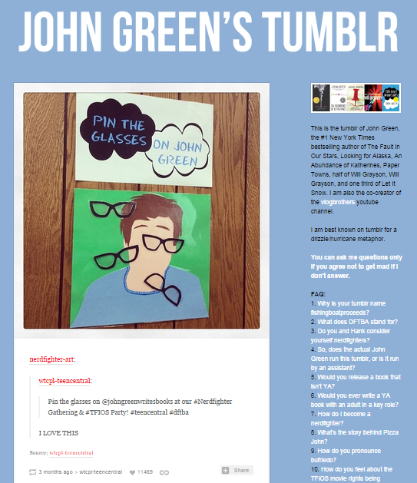
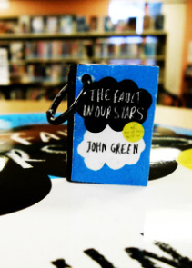
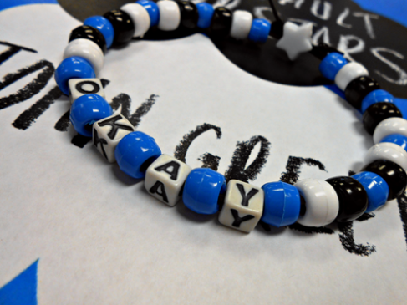
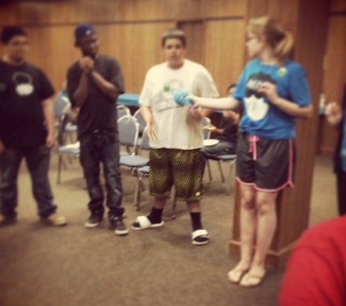
NERDFIGHTER GATHERING
Don’t forget to be awesome.
Pizza tasting contest!
Vlogbrother videos!
Book charms!
DFTBA/Okay? Bracelets!
Pin the glasses on John Green!
Hanklerfish Hot Potato!
I went to Nerdfighteria & all I
got was this awesome community.

Slide 12
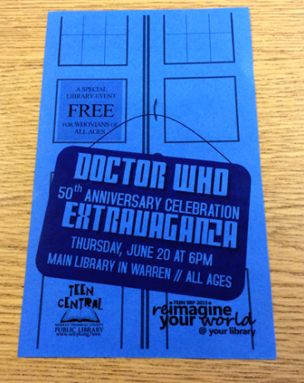
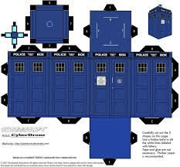
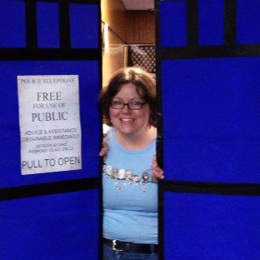
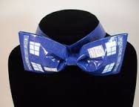
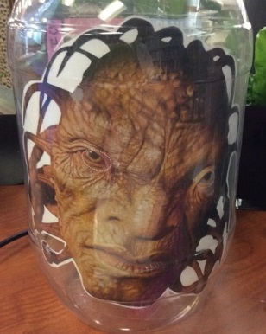
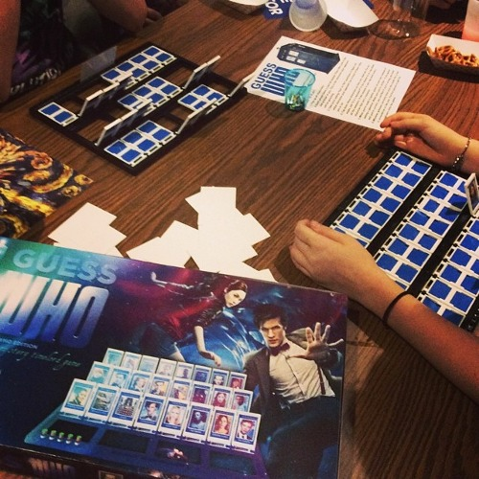

DOCTOR WHO
You might have noticed that Doctor Who has turned into a true global phenomenon. If you host a party, the Whovians will come…
Bowties
TARDIS photo op
Gallifreyan names
Don’t blink! staring contest
TARDIS Toss
Cyberman Says
BLINK! Don’t blink!
Van Gogh coloring sheets
Youtube videos
Paper TARDIS & Daleks
Trivia through Space & Time
Guess WHO
Bonus: Make fish fingers and custard!

Slide 13
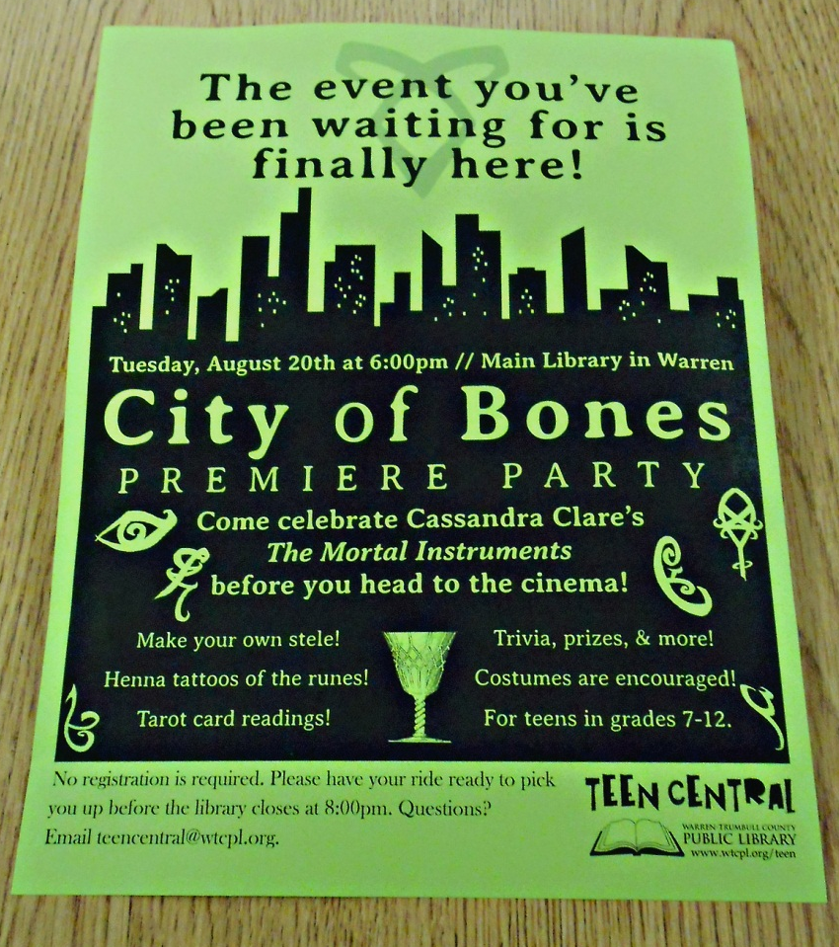
THE MORTAL INSTRUMENTS
The movie might have been terrible, but the books are still popular! Another series, called “The Shadowhunter Academy,” is coming…
Tarot card readings
Runes with black face paint
Book charms
Angelic rune necklaces
Book trivia

Slide 14

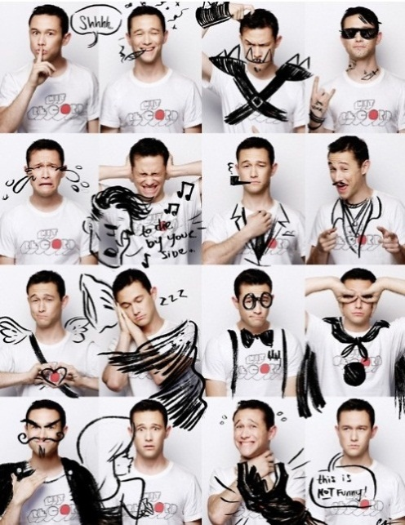
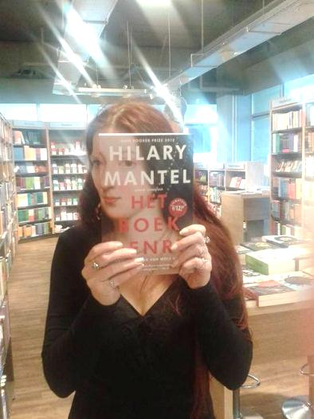
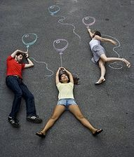
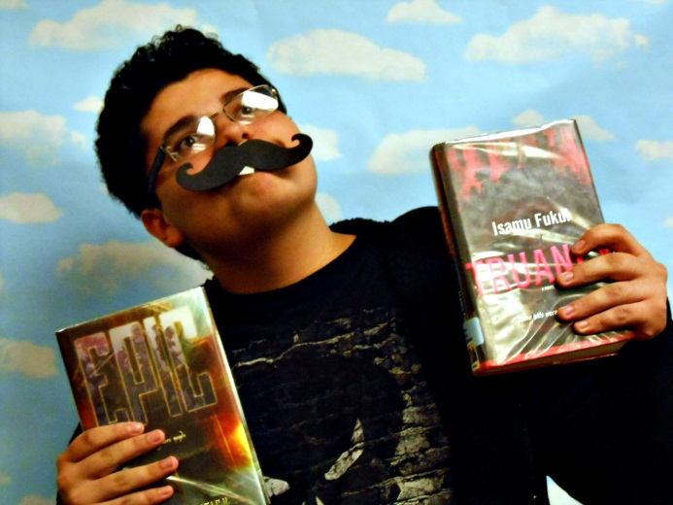
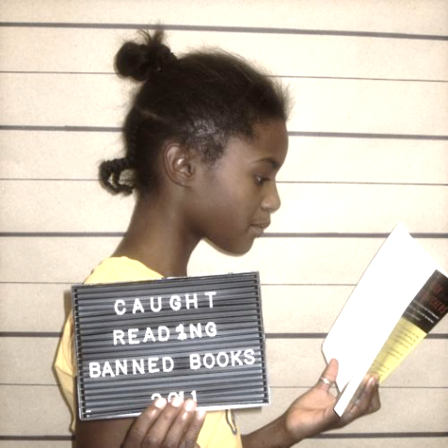

PHOTOGRAPHY Teens can play with
photography, or help create displays!
            Sleevefacing
            Banned books
            We mustache you to
            check out these books!
            Photo booth drawing
            Playing with Shadow

Slide 15

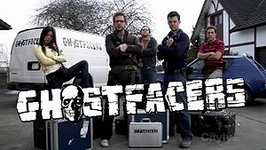
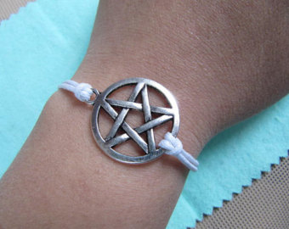
SUPERNATURAL SURVIVAL SKILLS 101
Can they survive the beasties of the night?
Perfect for your Supernatural fans!
Trivia
‘Pass the rabbit’s foot’ OR ‘Why did it
have to be snakes?’
Zombie tag
Pentacle charm bracelets
Watch the Ghostfacers!
BONUS: Serve pie!

Slide 16
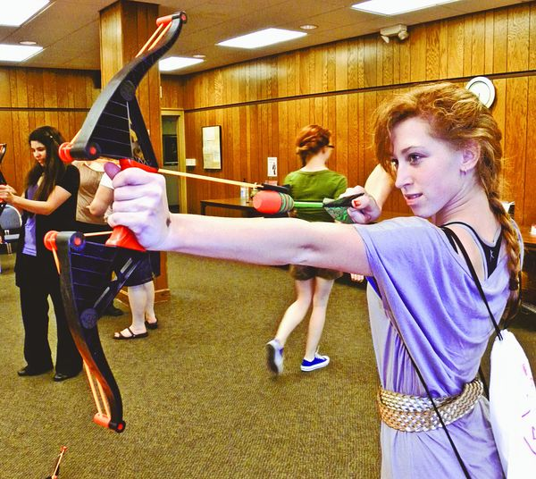
THE HUNGER GAMES SURVIVAL CHALLENGE
Challenging, intellectually stimulating, & fun!
Working with their District,
teens complete 10-15 challenges
by racing through the library
arena. All challenges are based
on either events in The Hunger
Games or on survival in nature,
like animal tracks, poisonous
plant identification, book trivia,
first aid, archery, etc.

Slide 17
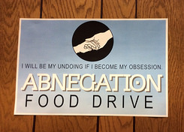
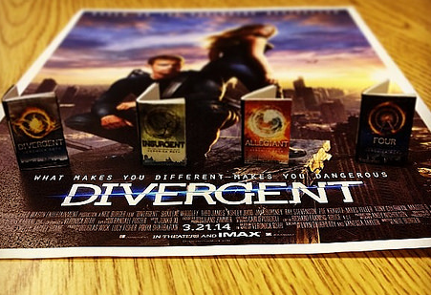
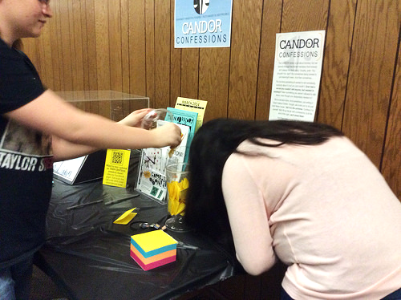
DIVERGENT
One choice can transform you…
Erudite trivia
Abnegation food drive
Amity arts & crafts (book charms)
Dauntless tattoos
Candor confessions
Movie poster print-outs
Bonus: Chocolate cake and t-shirts!

Slide 18
Bonus: Investments
Things worth having around!
Crayola Airbrush marker sprayer - $25
Rice cooker - $20
Cotton candy machine - $35
Sewing supplies (thread, yarn, needles, felt)
Pony beads (a big vat of them) & plastic yarn (Rex Lace)
Sharpies & paint markers
Popcorn maker
1” circle punch & small heart punch
Crank laminator
Note: Withdrawn books in excellent shape (those sad titles that never went out) make excellent prizes! Cut the tape, peel off the cellophane & barcodes, & voila! Keep a stack of those in your stash for instant prizes.

